Slide 1





Process-based models for predicting species’ responses to environmental changes
greta.bocedi@abdn.ac.uk
https://gretabocedi.com
@BocediGreta

Slide 2
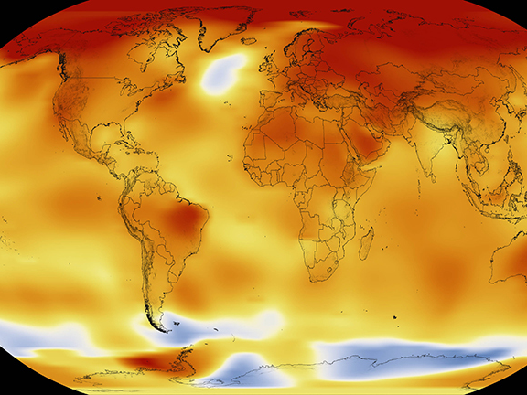
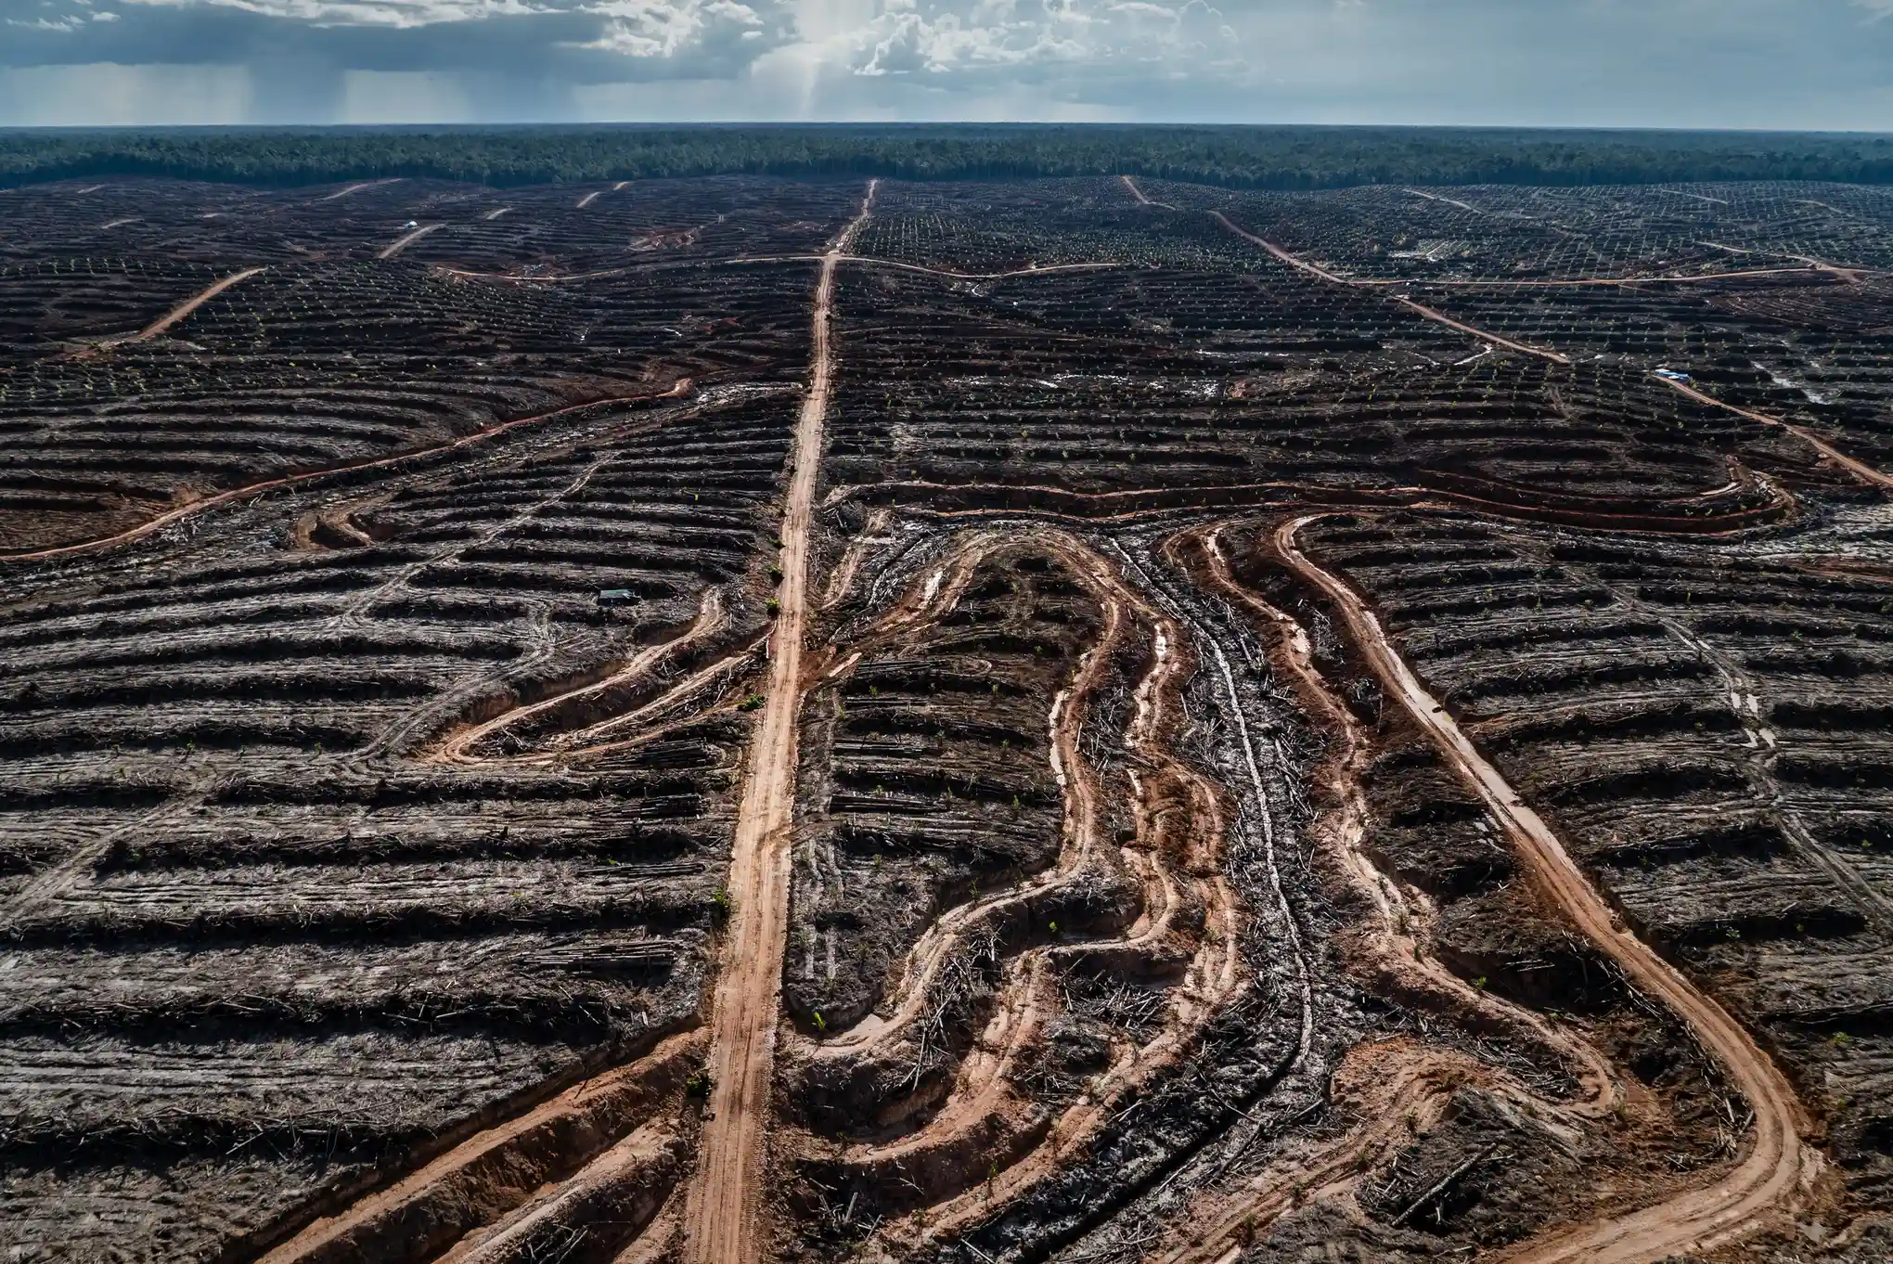
How will species respond to different interacting pressures?
Understand species’
eco-evolutionary dynamics
Predictive Models
How to best manage these responses?
Image Credit: right: NASA/Goddard Space Flight Center Scientific Visualization Studio. Left: Ulet Ifansasti/Greenpeace

Slide 3
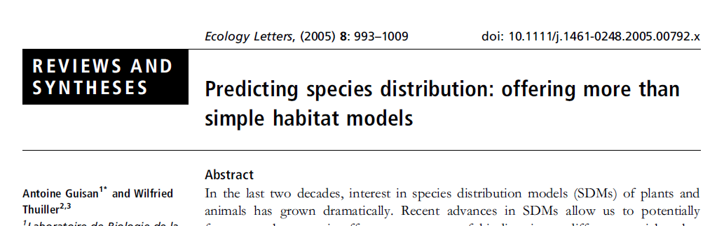
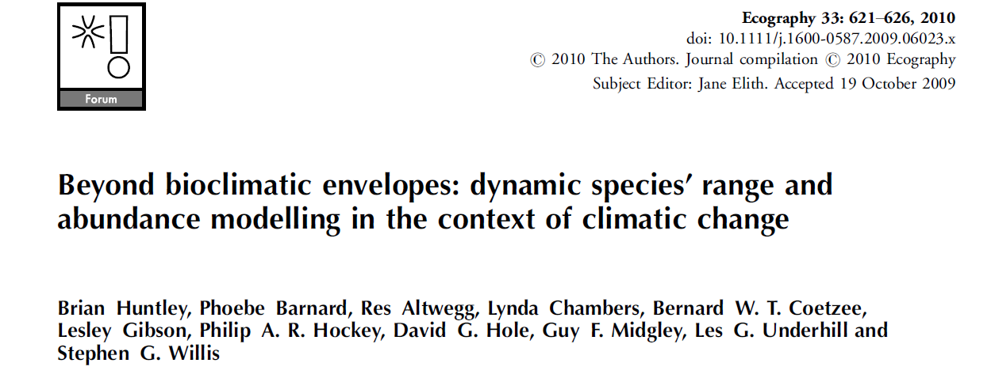
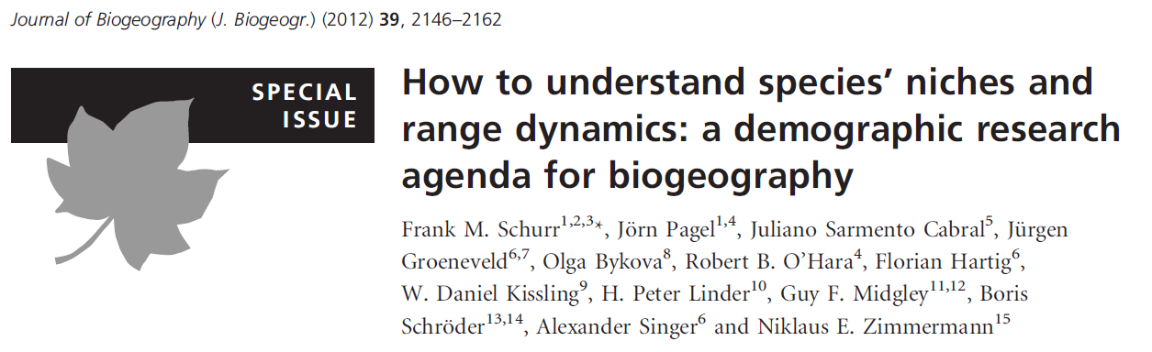
Eco-evolutionary
process-based
models
Image Credit: right: NASA/Goddard Space Flight Center Scientific Visualization Studio. Left: Ulet Ifansasti/Greenpeace

Slide 4

Correlative
models - SDM
Forward
models
Hybrid models
Process-based models
Species distributions
Environmental parameters
Ecological knowledge
Correlative SDMs statistically relate environmental variables directly to species occurrence or abundance
Parameters have no a priori defined ecological meaning
Processes are implicit
Process-based models formulate the ecology of a species as mathematical functions defining causality
Built around explicitly stated mechanisms
Parameters have a clear ecological
interpretation defined a priori
Reproduced from: Dormann et al. 2012, J.Biogeogr. 39:2119-2131

Slide 5
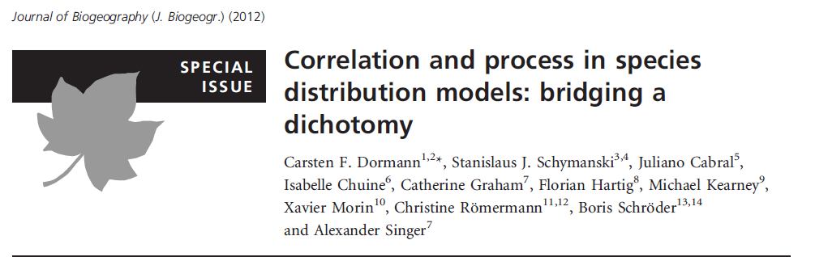
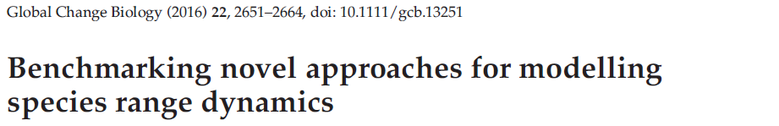
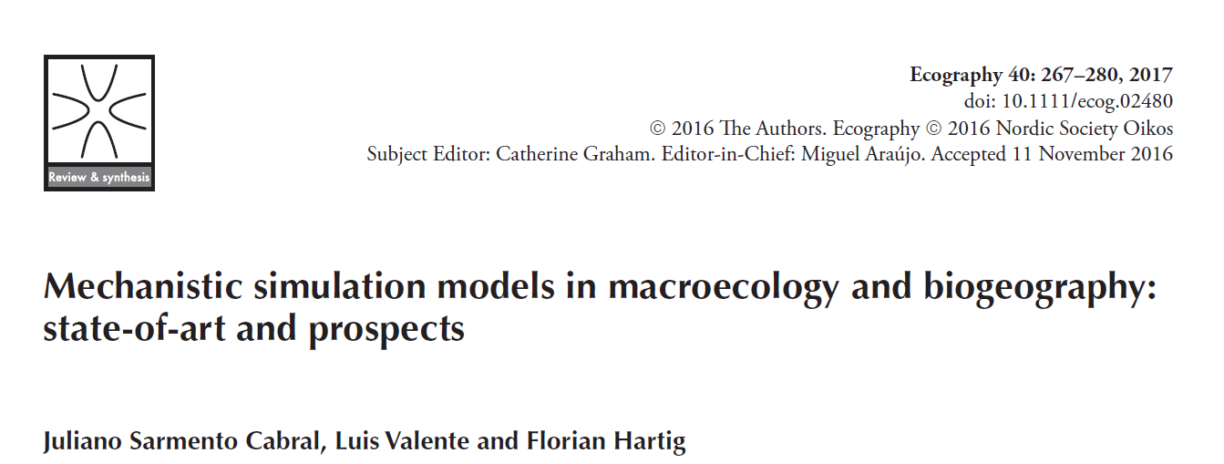
Process-based models
Advantages…
Rooted in ecological and evolutionary theory
Not based on correlations but on processes:
Causal links
Predictive power
Extrapolation
Generate new hypotheses
Briscoe et al. 2019
Uncertainty
Zurell et al. 2016
… and challenges
Complexity – How much is too much?
… which processes?
Data availability
Upscaling

Slide 6
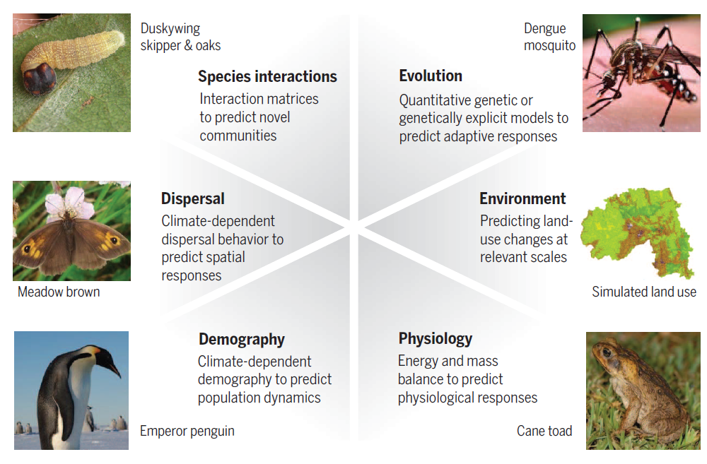
Which processes?
Urban, Bocedi et al. 2016, Science

Slide 7
Which processes?
Cabral et al. 2017, Ecography

Slide 8

Do process-based model perform better
than correlative ones?
… it depends….
Substantially improve predictions under climate change compared to purely correlative SDMs
Also predict reasonable extinction risks
More data required
SDMs may perform even better under current conditions

Slide 9
Process-based model: where are we at?
Cabral et al. 2017, Ecography

Slide 10
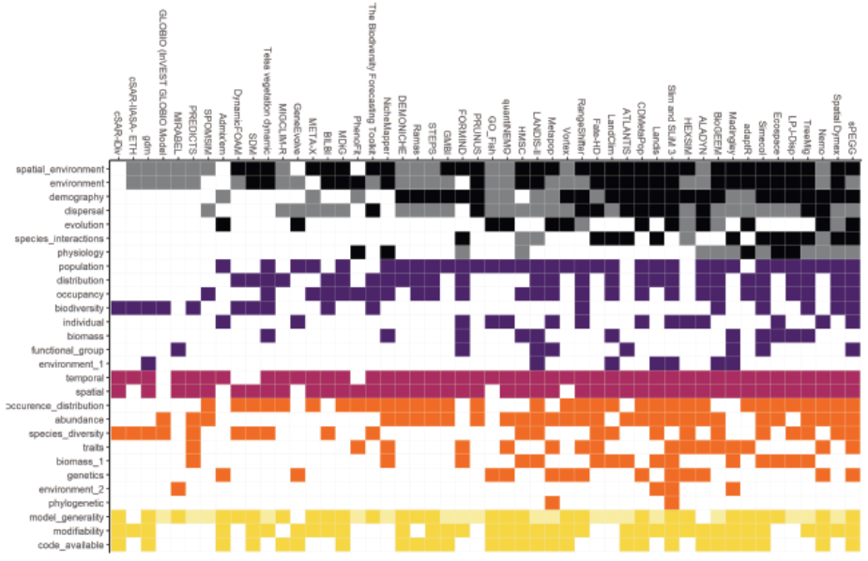

Correlative
models
Process-based models
Processes
Modelling unit → scale
Horizon
Outputs
Accessibility
Urban et al. 2021, BioScience

Slide 11
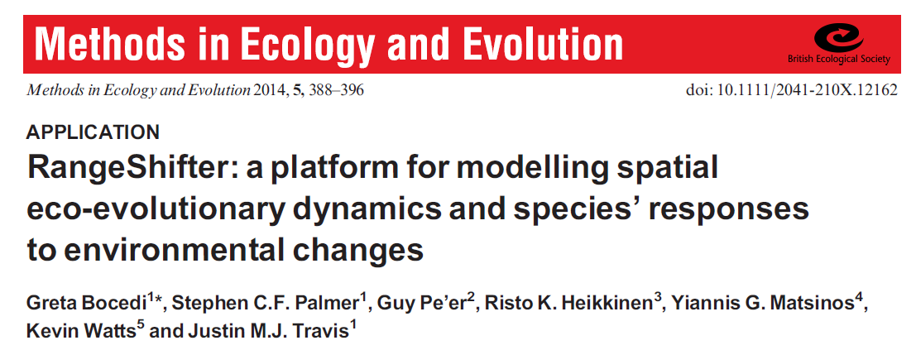
https://rangeshifter.github.io
Individual-based, spatially explicit, stochastic model
Species’ spatial dynamics, distribution & persistence
Landscape maps &
habitat suitability
Population dynamics
Eco-evolutionary responses to environmental changes
Species’ distribution
Environmental gradients
& stochasticity
Dispersal
In-silico testing of
management strategies

Slide 12

https://rangeshifter.github.io
2021
2021
@BocediGreta

Slide 13












INDIVIDUAL-BASED MODELS
Individuals and their interactions are the units of the simulation
INDIVIDUAL VARIABILITY
ECOLOGY

Slide 14
INDIVIDUAL-BASED MODELS
Individuals and their interactions are the units of the simulation
INDIVIDUAL VARIABILITY
ECOLOGY
GENETICS
Deleterious mutations
Neutral markers
Loci under selection (traits)
EVOLUTION

Slide 15
INDIVIDUAL-BASED MODELS
ECOLOGY
GENETICS
EVOLUTION

Slide 16
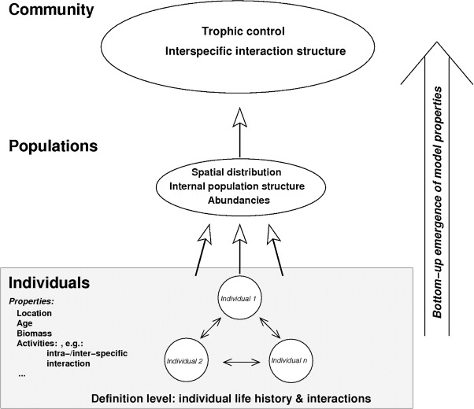
Emerging population dynamics
“The whole is more than the sum of its parts” – Aristotle
Bottom-up approach
use knowledge about behaviour of single individuals to infer properties of the larger population or community
Reuter, et al. (2010) Basic Appl Ecol 11: 572-581.

Slide 17
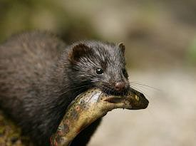
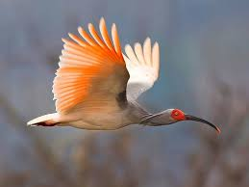
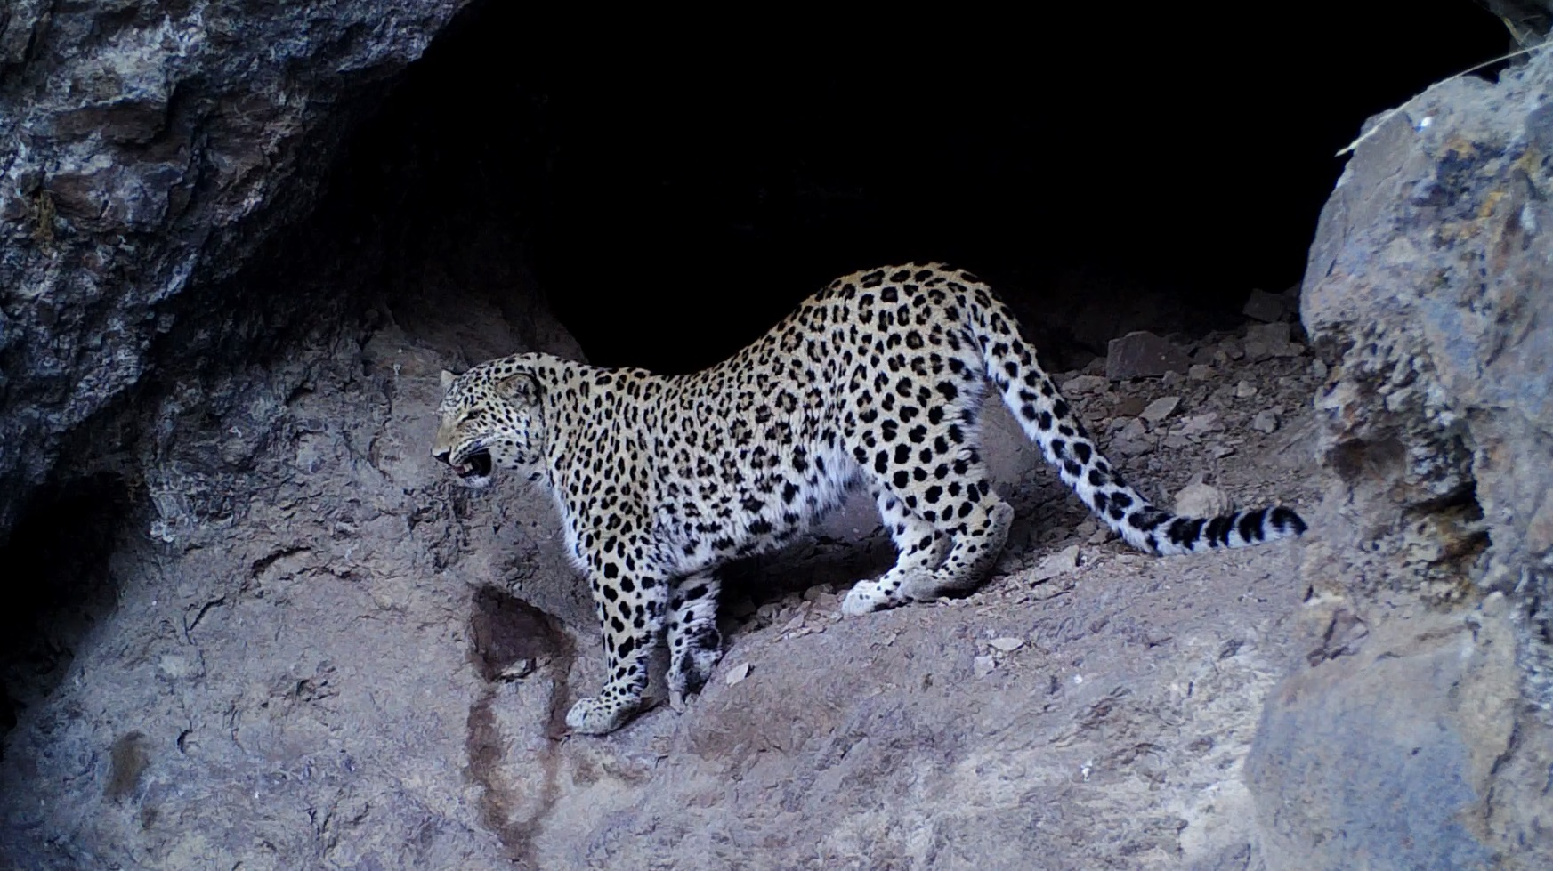
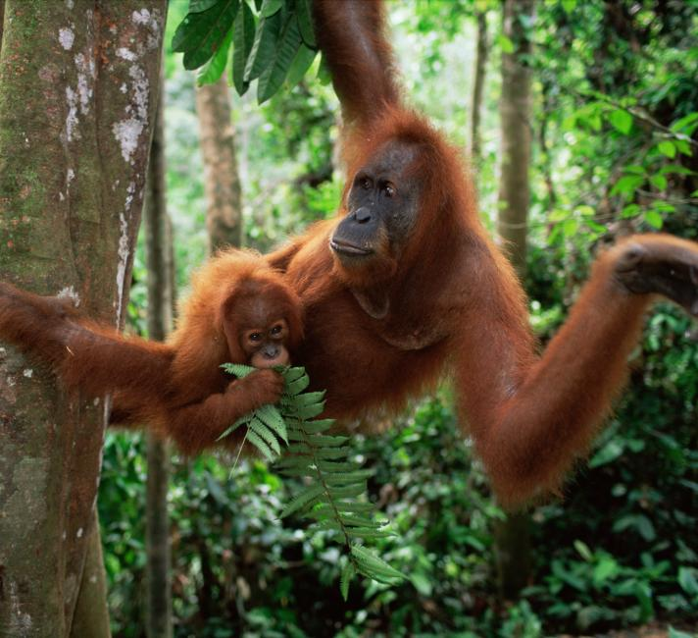
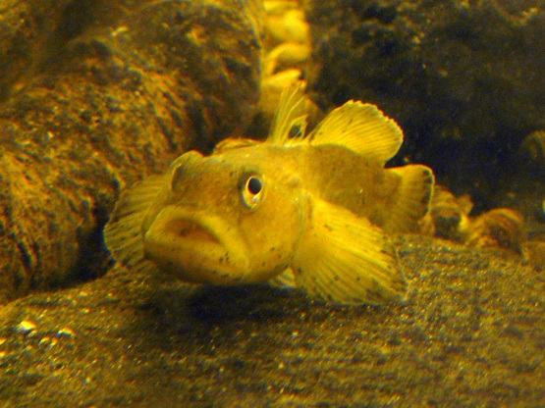
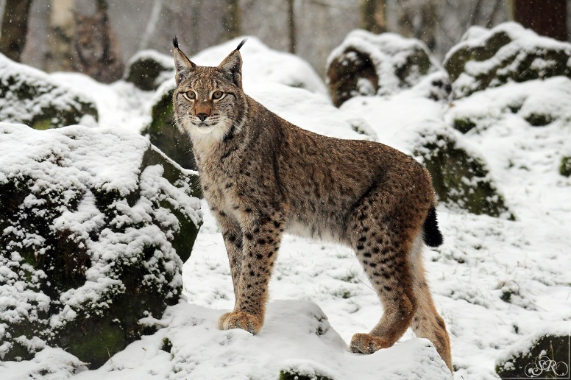
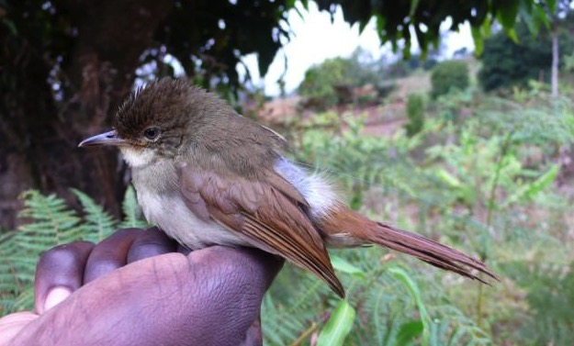
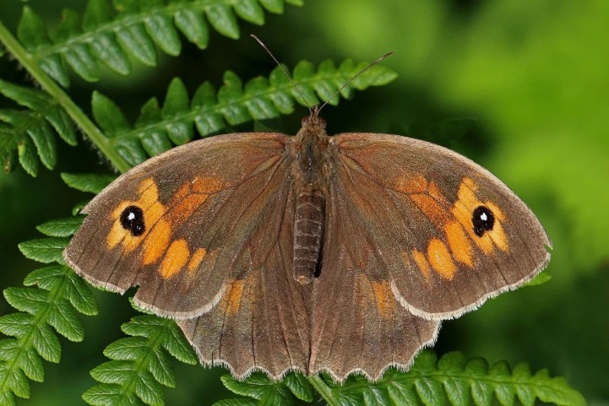
American mink
Asian crested ibis
Persian leopard
Fraser et al. 2015
Divers. Distrib.
Sun et al. 2016
Divers. Distrib.
Bleyhl et al. (2021) Ecol. Appl.
Investigate species’ eco-evolutionary responses to
environmental changes across their ranges
Develop new theory to increase understanding
Tool for exploring relative effectiveness of alternative management interventions
Orangutan
Seaman et al. (2021)
Landscape Ecol.
Samson et al. 2017 Front. Ecol. Evol.
Eurasian lynx
Cabanis’s greenbul
Heikkinen et al. 2015 Biol. Cons.
Ovenden et al. 2019
Biol. Cons.
Aben et al. 2016
J. Appl. Ecol.
Meadow brown
Round goby
@BocediGreta

Slide 18
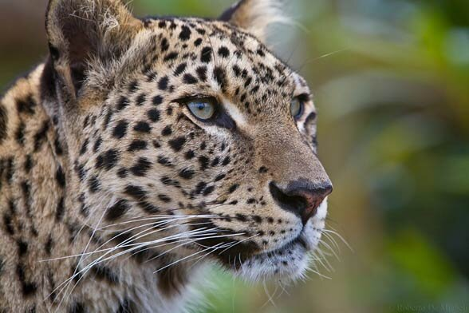

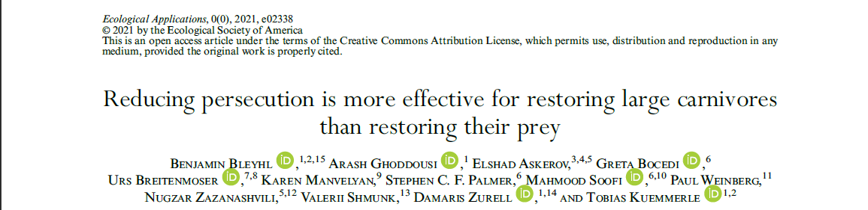
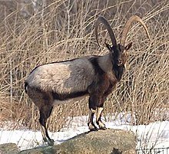
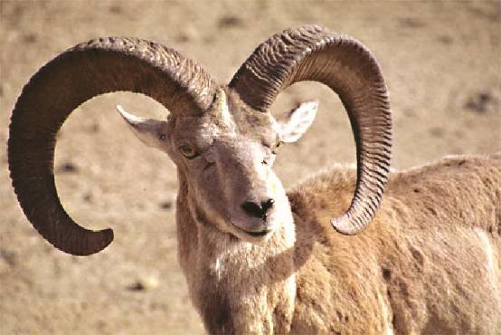
Bezoar goat
Persecution
Prey depletion
What is the potential spatial structure and size of a future Persian leopard metapopulation in the Caucasus?
How do persecution reduction & prey restoration affect metapopulation viability?
Urial sheep

Slide 19
Rule-based habitat suitability model
(validated with camera traps, scrapes and scats from WWF’s Caucasus Programme Office)
Photo credit: WWF-Caucasus
Bleyhl et al. 2021, Ecol. Appl.

Slide 20
Rule-based habitat suitability model
(validated with camera traps, scrapes and scats from WWF’s Caucasus Programme Office)
Parameterize a spatially-explicit population model
Prey restoration scenarios
Persecution reduction scenarios
Bleyhl et al. 2021, Ecol. Appl.

Slide 21
after 100 years
Bleyhl et al. 2021, Ecol. Appl.

Slide 22
The Caucasus has the potential to host a viable leopard metapopulation
if the appropriate conservation measures are implemented
High mortality is the main constraints to population growth in the region
Strict low enforcement against poaching
Carnivore-adapted live stock husbandry
Prey restoration is also needed
Bleyhl et al. 2021, Ecol. Appl.

Slide 23
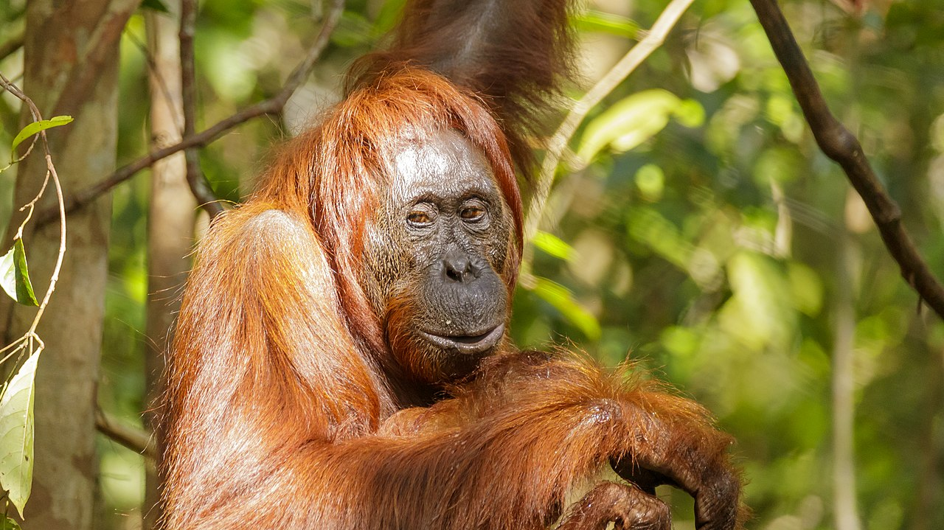

What is the impact of potential management scenarios for a highly modified oil-palm dominated landscape in Sabah, Malaysian Borneo, on the Orangutan populations?

Slide 24
Seaman et al. 2021, Landscape Ecol.

Slide 25
Seaman et al. 2021, Landscape Ecol.

Slide 26
Limited connectivity – individuals confined in protected areas
Increased connectivity but not population size
Much increased connectivity and increased population size
Potential of human-modified landscapes to support orangutan populations
Seaman et al. 2021, Landscape Ecol.

Slide 27
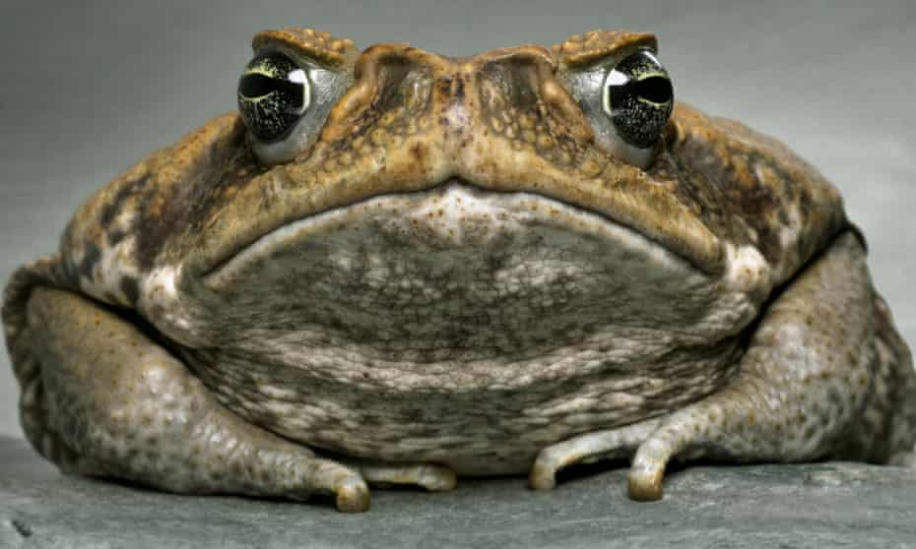
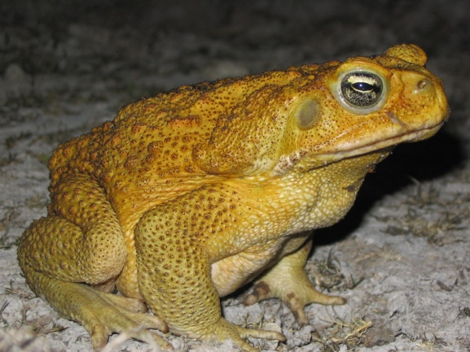
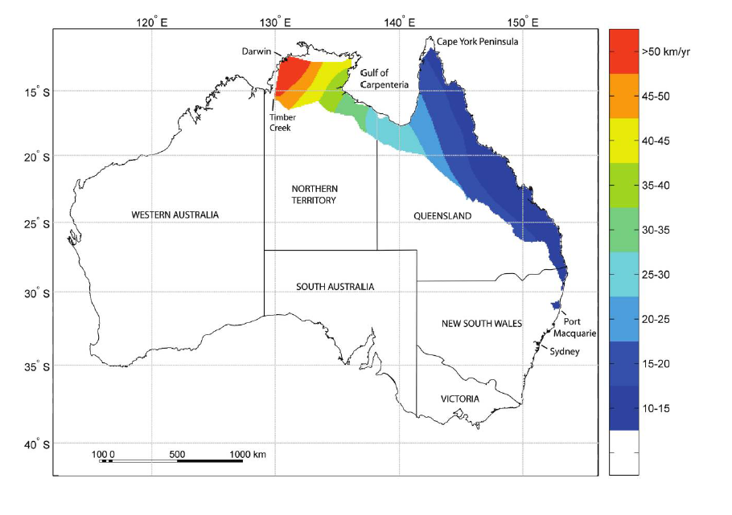
Eco-evolutionary dynamics during species’ range shifting:
EVOLUTION of DISPERSAL
Chaunus [Bufo] marinus
Cane toad
21 years before 1985 forecast that assumed constant expansion rates!
Phillips et al. 2008, Am.Nat.; Urban et al. 2008, Am.Nat.; Phillips et al. 2006, Nature

Slide 28

Eco-evolutionary dynamics during species’ range shifting:
Evolution of dispersal
Expansion
Contraction
Highly dispersive individuals evolve
At the start of climate change the species lags behind the climate window
species lags behind climate window
Higher dispersal distances evolve (light blue/white)
Range catches up with climate
Suitable climate space
At the end of climate change, dispersal evolves back → range contracts, ‘elastic margin’
Optimum
Time
Henry, Bocedi & Travis 2013, Journal of Theoretical Biology

Slide 29

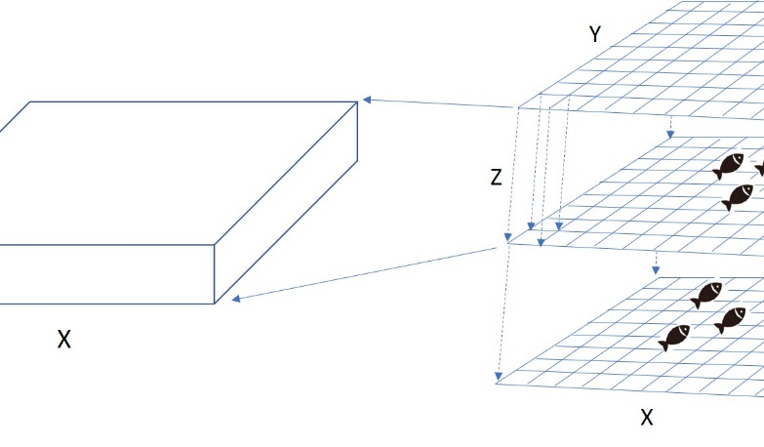
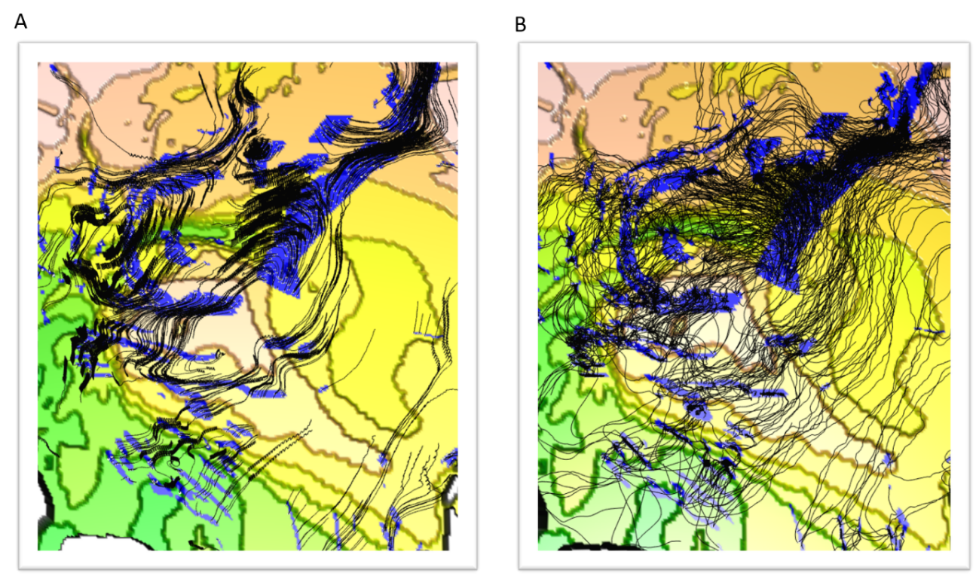

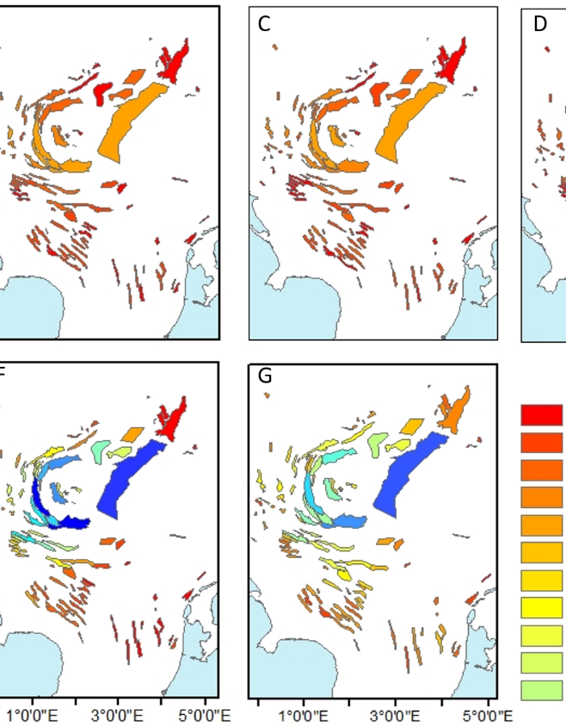
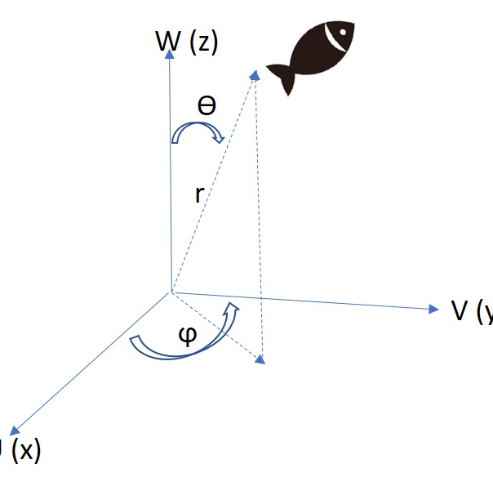
Coming very soon:
MerMADE
(RangeShifter for Marine environments)

